Slide 1
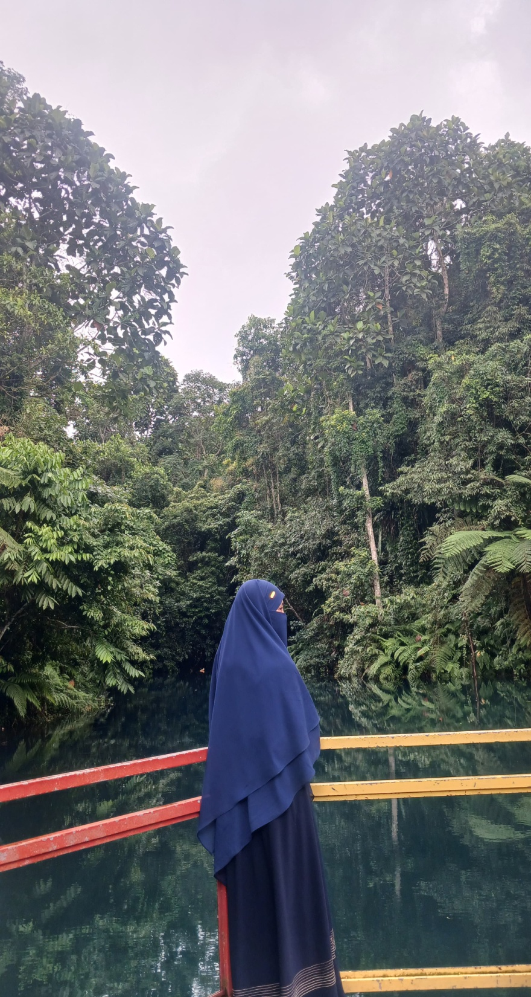
Nadhiroh Ismail
naadhirohismail@gmail.com
Jl.Segaranak No.16
Detile Profile

