Slide 1
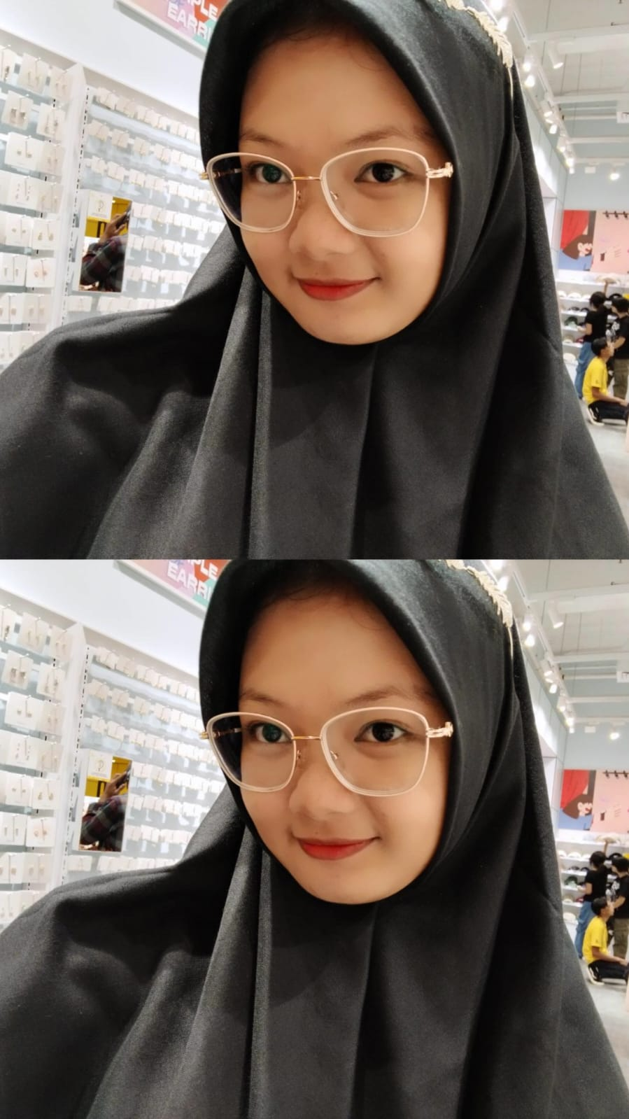
Zya Melca
zya,melca8@gmail.com
Aikmel Lombok Timut
Detile Profile

